Slide 1
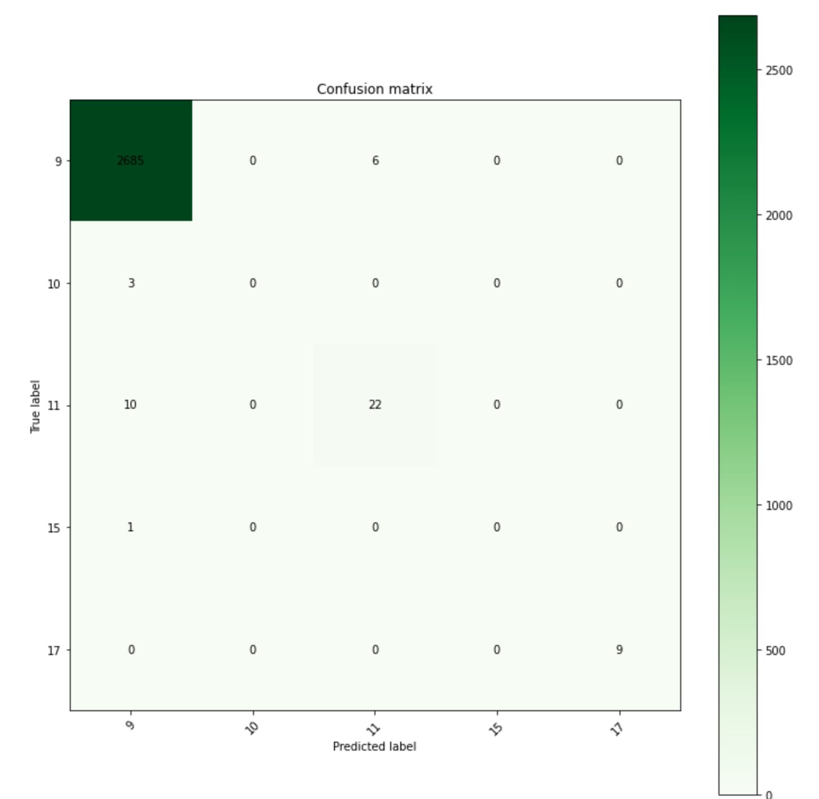
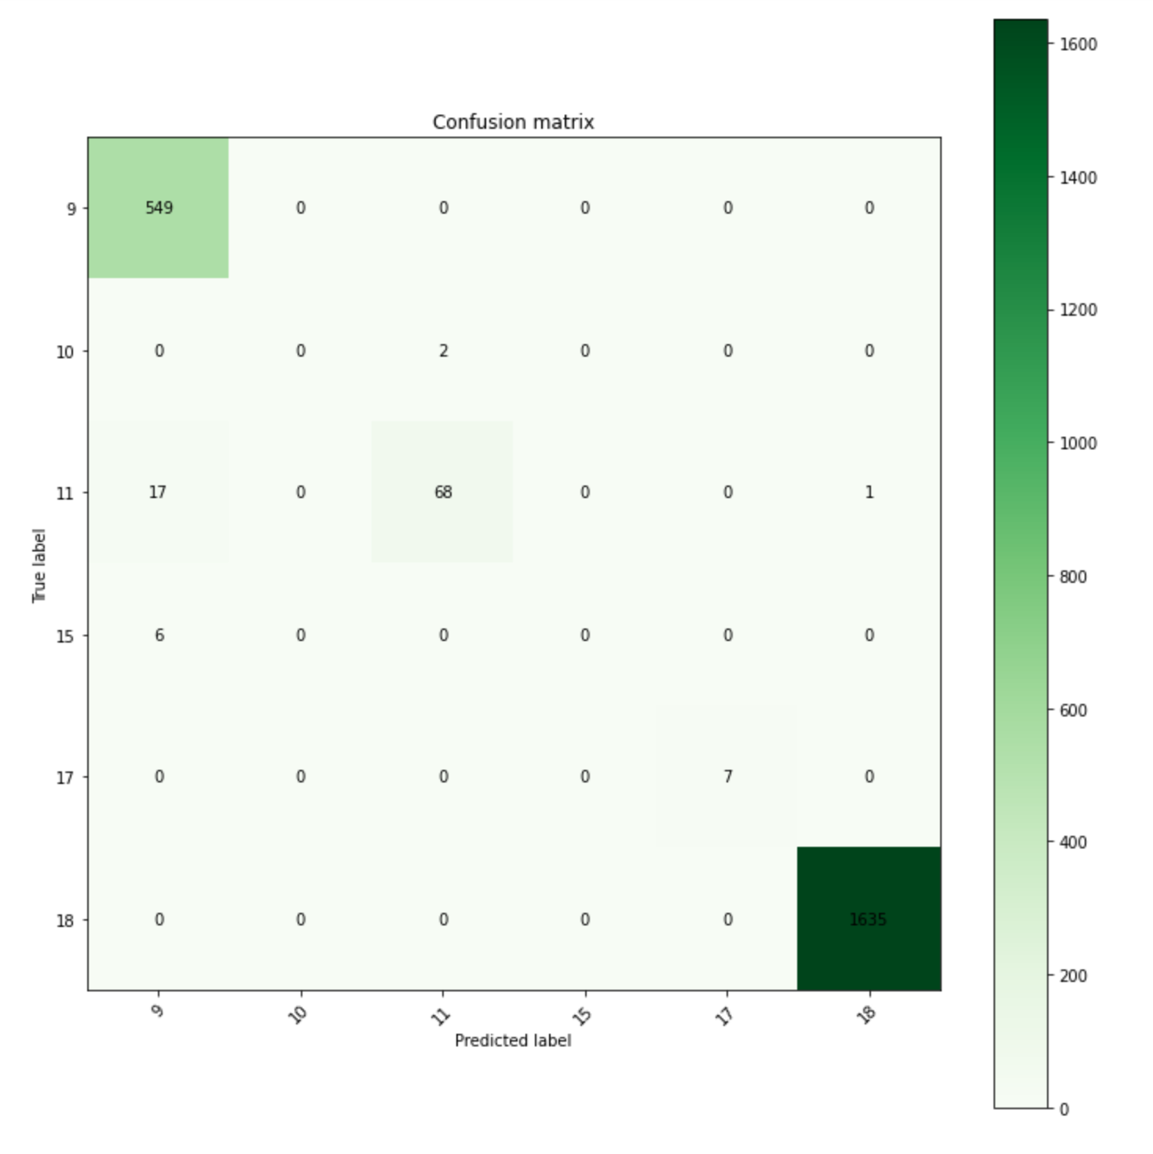
SHORT RECAP
pct_anomalies = 0.05
pct_anomalies = 0.01

Slide 2
LAB 3
WHAT IF YOU HAD NO IDEA WHAT YOUR ANOMALIES ARE GOING TO LOOK LIKE?

Slide 3
LAB 3
(OR)
YOUR DATA DOES NOT FOLLOW A GAUSSIAN DISTRIBUTION?

Slide 4
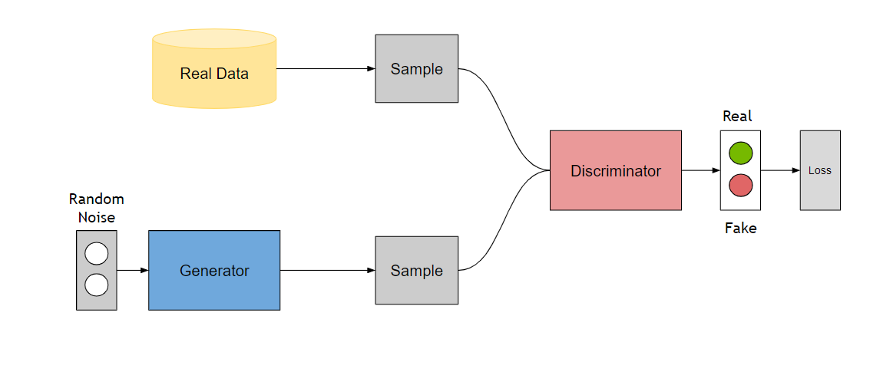
GENERATIVE ADVERSARIAL NETWORKS
A generative model that learns to generate samples that have the same characteristics as the samples in the dataset.
The Generator, `G`, produces fake samples
The discriminator, ‘D’, receives samples from both G and the dataset.
During Training: The generator tries to fool the discriminator by outputting values that resemble real data and the discriminator tries to become better at distinguishing between the real and fake data.

Slide 5
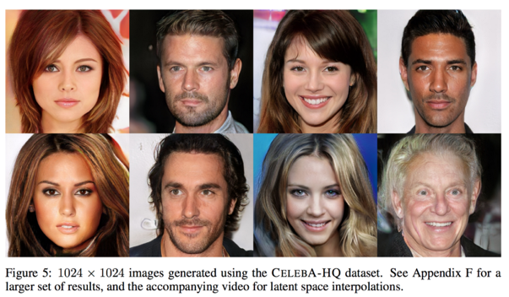
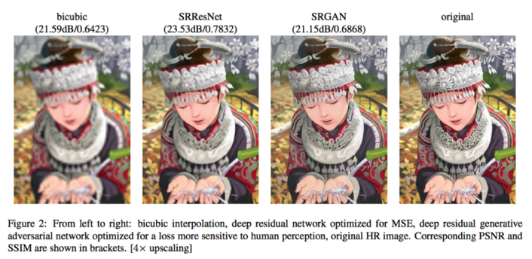

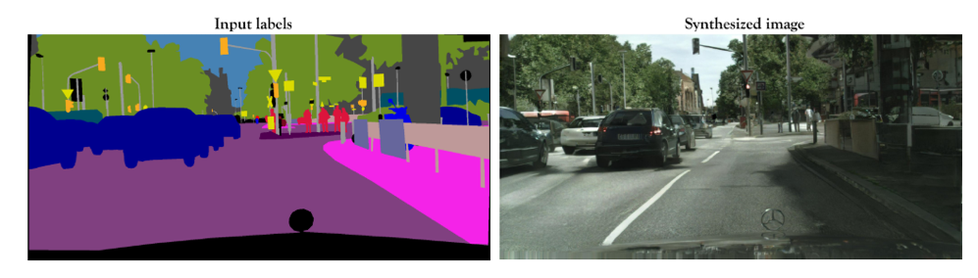
GAN APPLICATIONS
pix2pixHD

Slide 6
TRAINING THE GAN
STEP 1
Input
Journal Entry
Output
Journal Entry
duration | %%%%
src_bytes | %%%%
service | %%%%
flag | %%%%
src_bytes | %%%%
. . .
dst_host_srv_rerror_rate | %%%%
Generate Fake Sample
duration | #####
src_bytes | #####
service | #####
flag | #####
src_bytes | ####
. . .
dst_host_srv_rerror_rate | ####
Generator
Meaningless Output

Slide 7
TRAINING THE GAN
duration | #####
src_bytes | #####
service | #####
flag | #####
src_bytes | ####
. . .
dst_host_srv_rerror_rate | ####
STEP 2
Generator Output
Tune Discriminator Weights
Discriminator
0
Output
Score
-
1
duration | 0
src_bytes | 215
service | http (1)
flag | SF (1)
src_bytes | 215
. . .
dst_host_srv_rerror_rate | 0
Real Data Sample
Error

Slide 8
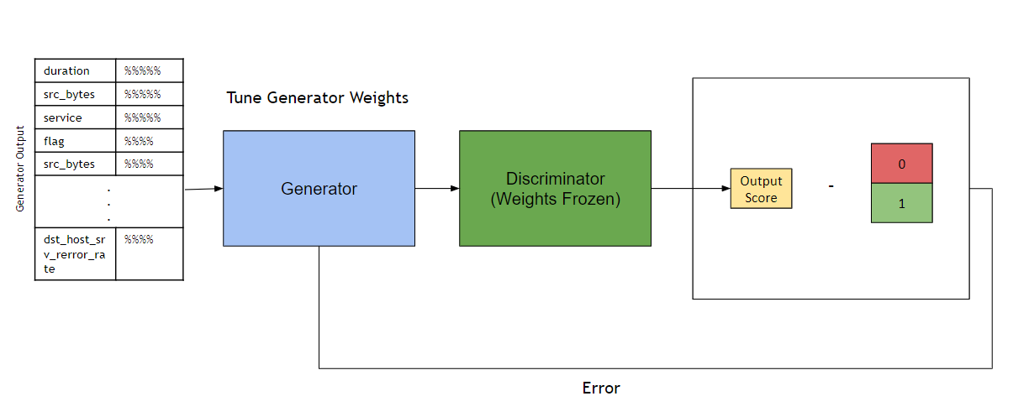
TRAINING THE GAN
STEP 3

Slide 9
TRAINING THE GAN
BACK TO STEP 1
Input
Journal Entry
Output
Journal Entry
duration | %%%%
src_bytes | %%%%
service | %%%%
flag | %%%%
src_bytes | %%%%
. . .
dst_host_srv_rerror_rate | %%%%
Generate Fake Sample
duration | 0
src_bytes | 215
service | http (1)
flag | SF (1)
src_bytes | 215
. . .
dst_host_srv_rerror_rate | 0
Generator
Meaningful Output

Slide 10

ANOMALY DETECTION
Input Test Point
duration | 0
src_bytes | 215
service | http (1)
flag | SF (1)
src_bytes | 215
. . .
dst_host_srv_rerror_rate | 0
Discriminator
Normal
P = 0.95

Slide 11
ANOMALY DETECTION
Input Test point
duration | 99999
src_bytes | 3239862
service | 5454
flag | SF (1)
src_bytes | 215
. . .
dst_host_srv_rerror_rate | 0
Discriminator
Anomaly
P = 0.33

Slide 12
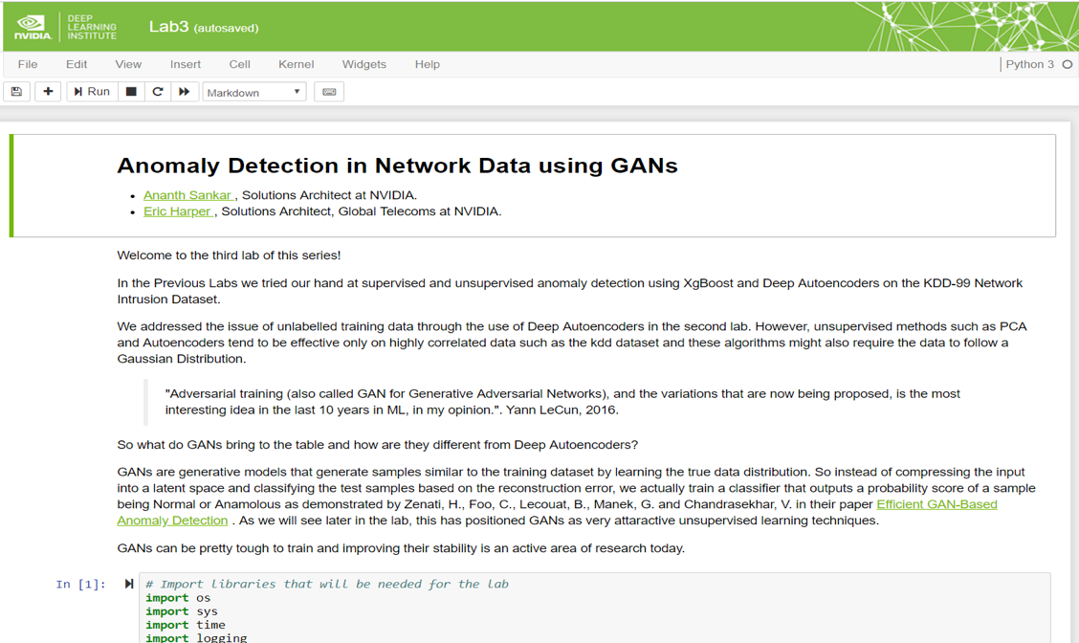
LAB 3 WALKTHROUGH

